Slide 1
Introduction project to barema. Objective k? Real world problem k solve garcha
Yesle k problem solve garcha?
Data set ko brief description kati ota data cha? (training data kati test data kati validation kati) preprocessing processes haru ko halka part. Group by.
Model kasari banayo grid search cv k k use garyo. (results k aayo accuracy) ani csv ma download garyo prediction ko.
Graphs ra foto model ko screenshot
Applications(ka use garna milcha yo project)
Difficulties
conclusions

Slide 2
HealthCare Provider Potential Fraud Detection
By:
Ashesh Byanju

Slide 3
Introduction
Provider Fraud is the biggest problem faced in Healthcare in US specially in Medicare program.
The largest healthcare provider fraud takedown in US history was around $1.3 billion, according to HHS and the Office of the Inspector General (OIG).
Types of fraud can be forgery, bribes, fake patients, and falsified billings
To financially benefit from public programs such as Medicare and Medicaid
Due to this reason, insurance companies increased their insurance premiums and as result healthcare is becoming costly day by day
Notes:
Healthcare in US is very costly and not everyone can afford it.
insurance companies increased their insurance premiums and as result healthcare is becoming costly day by day. One of the main reason is false claims.
The largest healthcare provider fraud takedown in US history was announced just recently, resulting charges against 400 defendants in 41 federal districts for schemes totaling $1.3 billion, according to HHS and the Office of the Inspector General (OIG).
Providers involved in fraud relied on creative schemes such as forgery, bribes, fake patients, and falsified billings to financially benefit from administrative vulnerabilities in public programs such as Medicare and Medicaid
Due to this reason, insurance companies increased their insurance premiums and as result healthcare is becoming costly day by day
So, objective of this project is to predict potential frauds beforehand to identify false claims and prevent increasing healthcare cost and insurance premium.

Slide 4
Objectives
To predict the potential fraudulent providers based on the claims filed by them
Discover important variables to detect the behaviour of potentially fraud providers
Understand the future behaviour of providers by studying fraudulent patterns in the provider's claims.
Prevent increasing healthcare cost and insurance premium.
Data consists of inpatient claims, Outpatient claims and Beneficiary details of each provider.
Notes:
So, objective of this project is to predict potential frauds beforehand to identify false claims and prevent increasing healthcare cost and insurance premium.

Slide 5
Brief Description of Dataset
We have three datasets consisting of Inpatient claims, Outpatient claims and Beneficiary details of each provider.
Inpatient data:
Claims filed for those patients who are admitted in the hospitals.
Provides additional details like their admission and discharge dates and admit diagnosis code.
Outpatient data:
Detail claims about those patients who visit hospitals and not admitted in it.
Beneficiary data contains of details of patient personal informations like health conditions, region they belong to etc.
Notes:
Inpatient data provides insights about the claims filed for those patients who are admitted in the hospitals. It also provides additional details like their admission and discharge dates and admit diagnosis code.
Outpatient data provides details about the claims filed for those patients who visit hospitals and not admitted in it.
Beneficiary data contains of details of patient personal informations like health conditions, region they belong to etc.

Slide 6
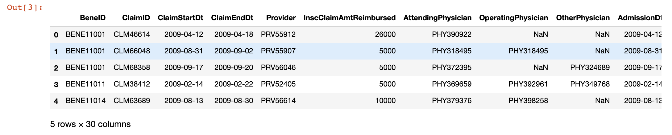
Dataset
Notes:
Altogether there were 3 dataset for train. This is a snapshot of sample dataset. Train target dataset had a provider information which was categorized into whether they were potential fraud or not. But test target data set hadn’t that information. So, I split train into train and validation, to see how model performs on unseen dataset.
Shape of Train data : (5410, 2)
Shape of Train_Beneficiarydata data : (138556, 25)
Shape of Train_Inpatientdata data : (40474, 30)
Shape of Train_Outpatientdata data : (517737, 27)
Shape of Test data : (1353, 1)
Shape of Test_Beneficiarydata data : (63968, 25)
Shape of Test_Inpatientdata data : (9551, 30)
Shape of Test_Outpatientdata data : (125841, 27)

Slide 7
Data Cleaning, Preprocessing and Feature Engineering
Changed values in columns.
Combine all 3 datasets (558211, 55)
Adding new features using existing features
Removed unused and redundant features
Checked nan values and filled nan with zeros
And finally grouped each column by provider (matching with target data)
Notes:
Many of column had values 1,2 where 1 was yes and 2 was no, so changed 2 to 0.
Similarly some columns had values [0, Y], so, made it uniform.
Few features were added using existing features like age using DOB and DOD,
Combine Inpatient, Outpatient, beneficiary datasets for both train and test
Most of the data were null so new features were added combining columns and deleted unused features from dataset

Slide 8
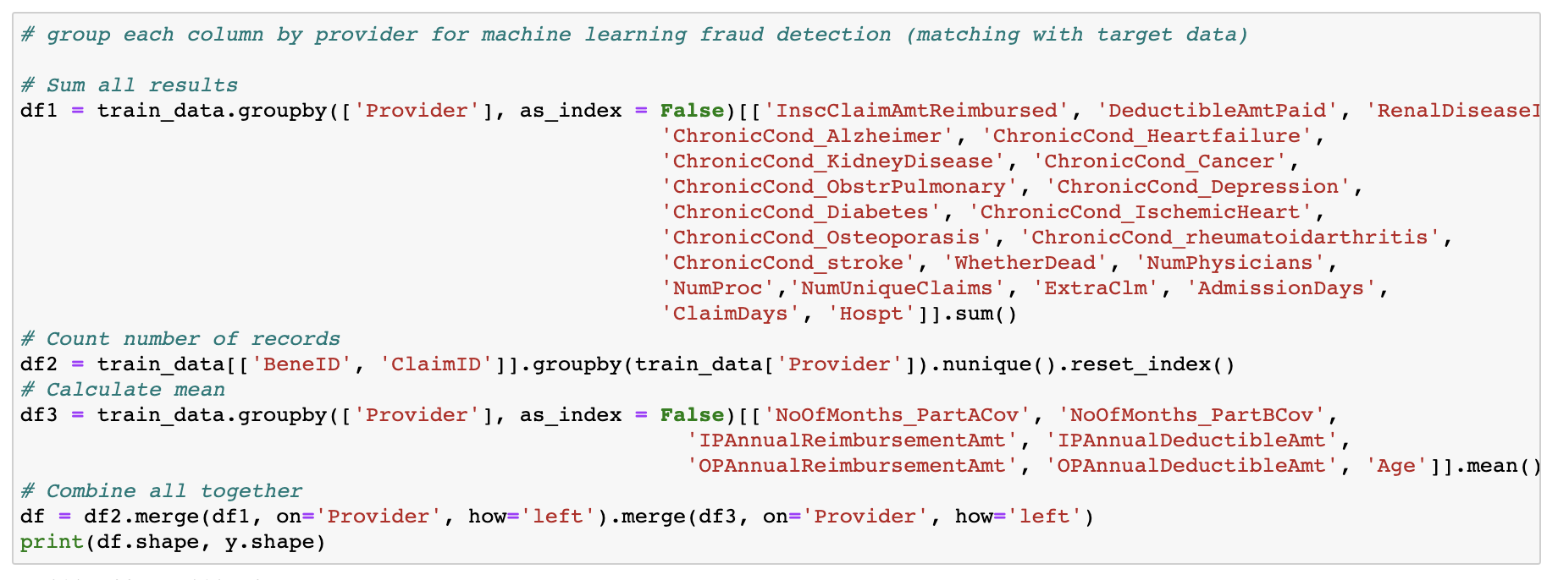

Slide 9
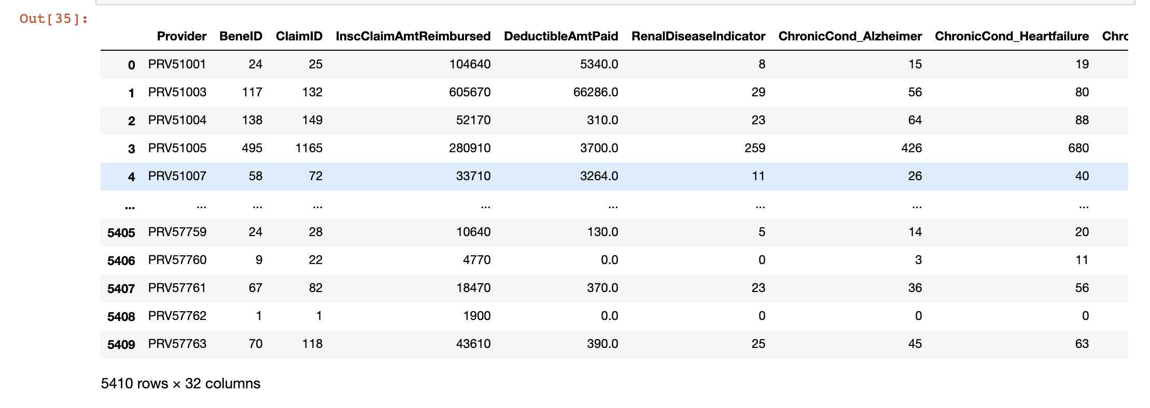
Final dataset

Slide 10

Machine Learning Algorithm

Slide 11
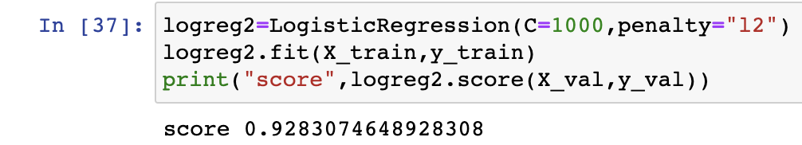
Logistic Regression
Splitted train data into train and validation
Used standard scalar for preprocessing
Used grid search and cross validation to find the best performing parameter.
Score was 92.83%
Notes:
No 1282
Yes 71

Slide 12
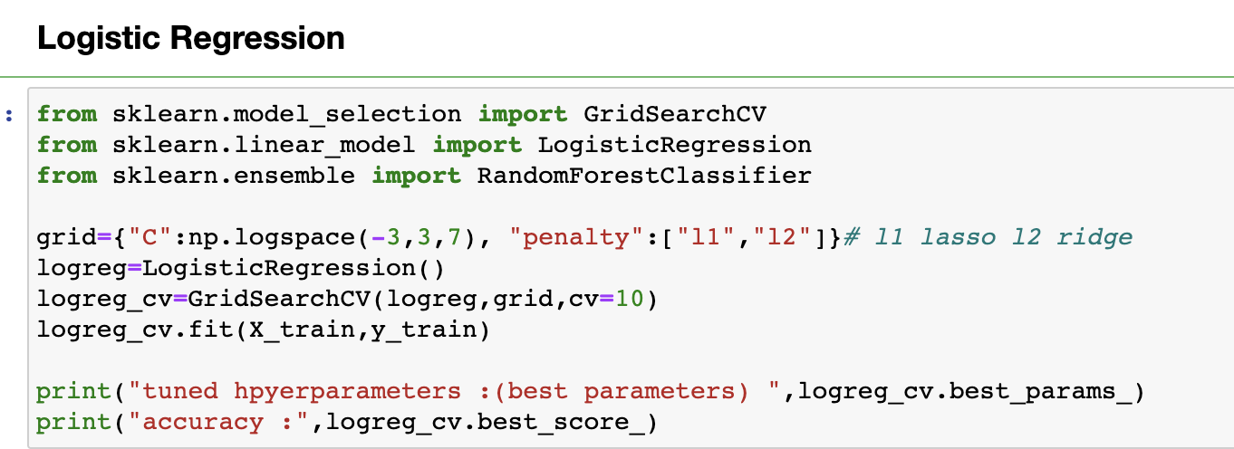

Slide 13
Random Forest:
Used grid search to find the best performing parameter.
Score was 92.38%
Notes:
No 1291
Yes 62

Slide 14
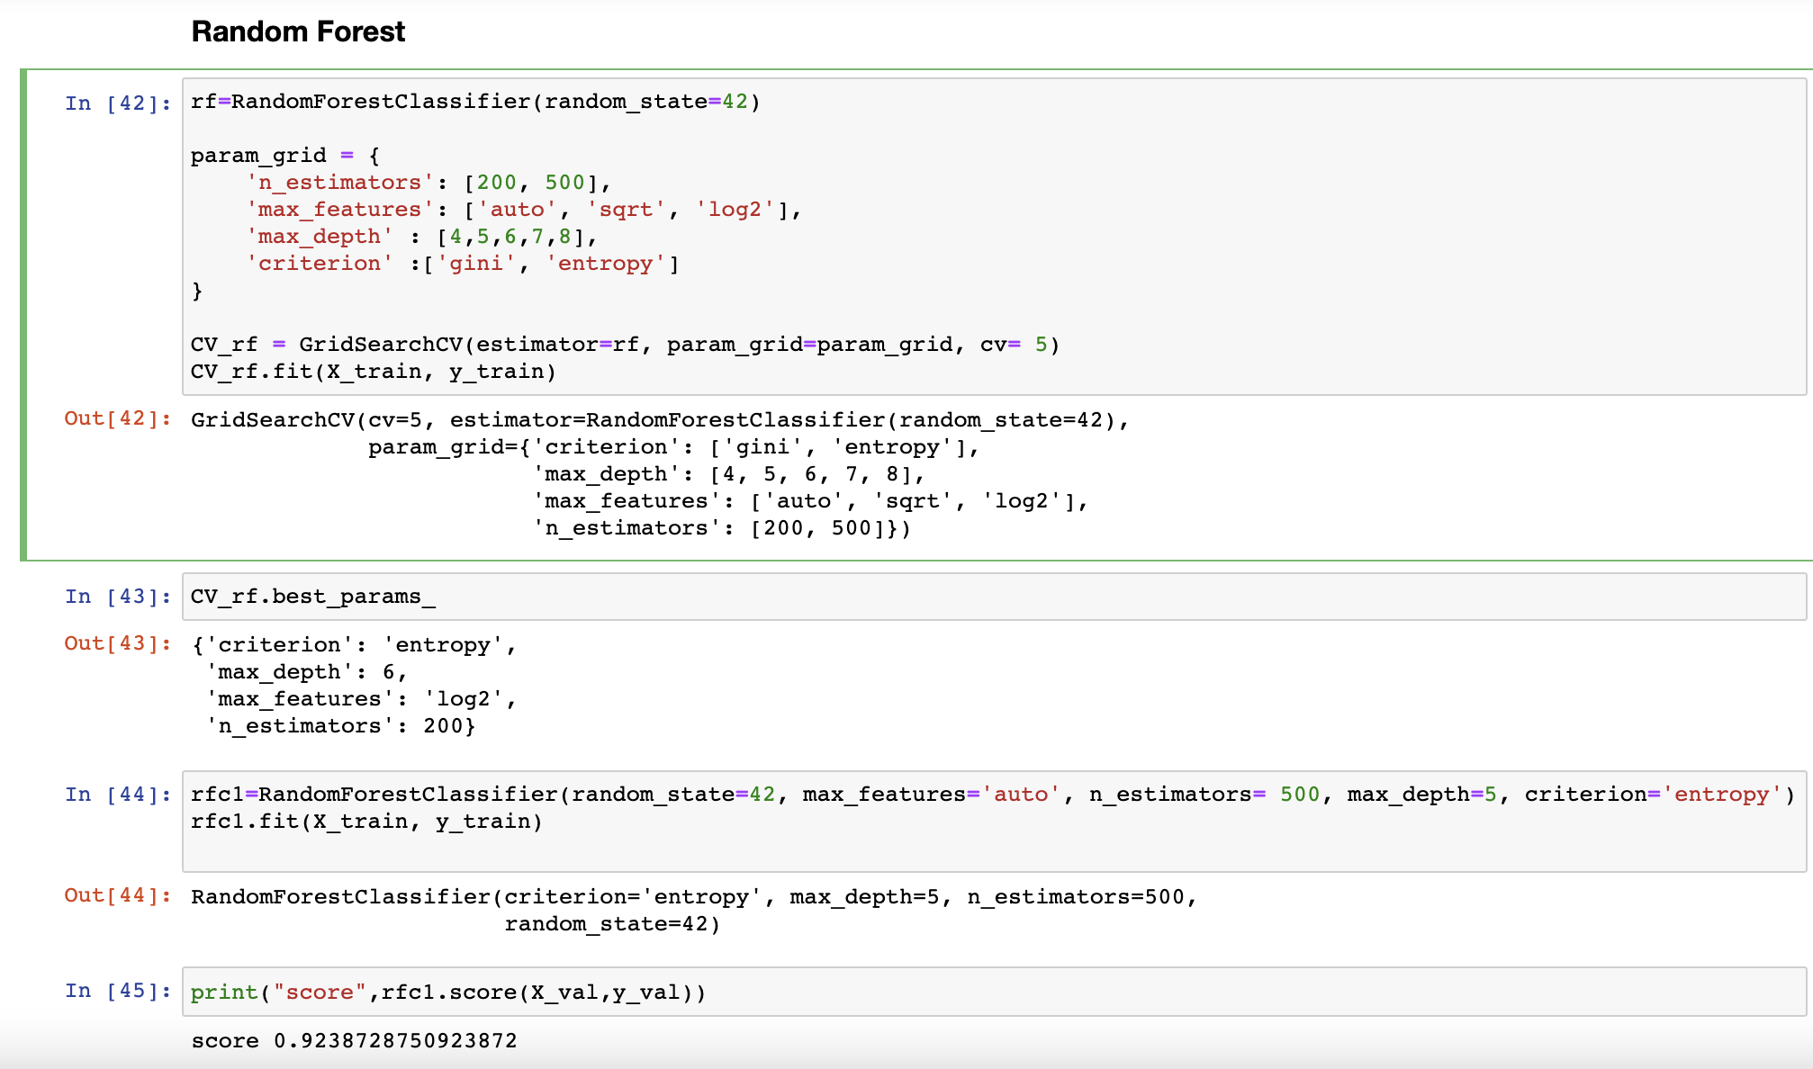

Slide 15
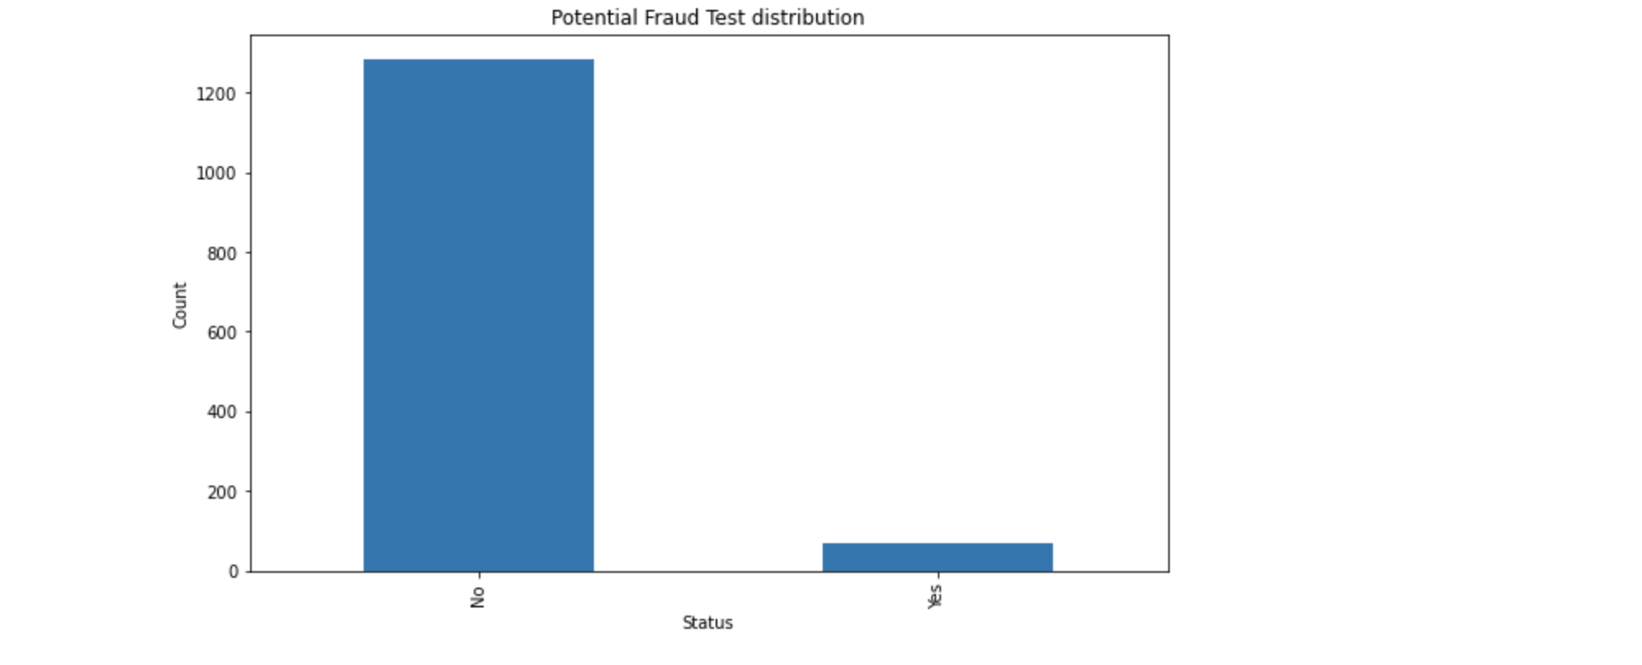
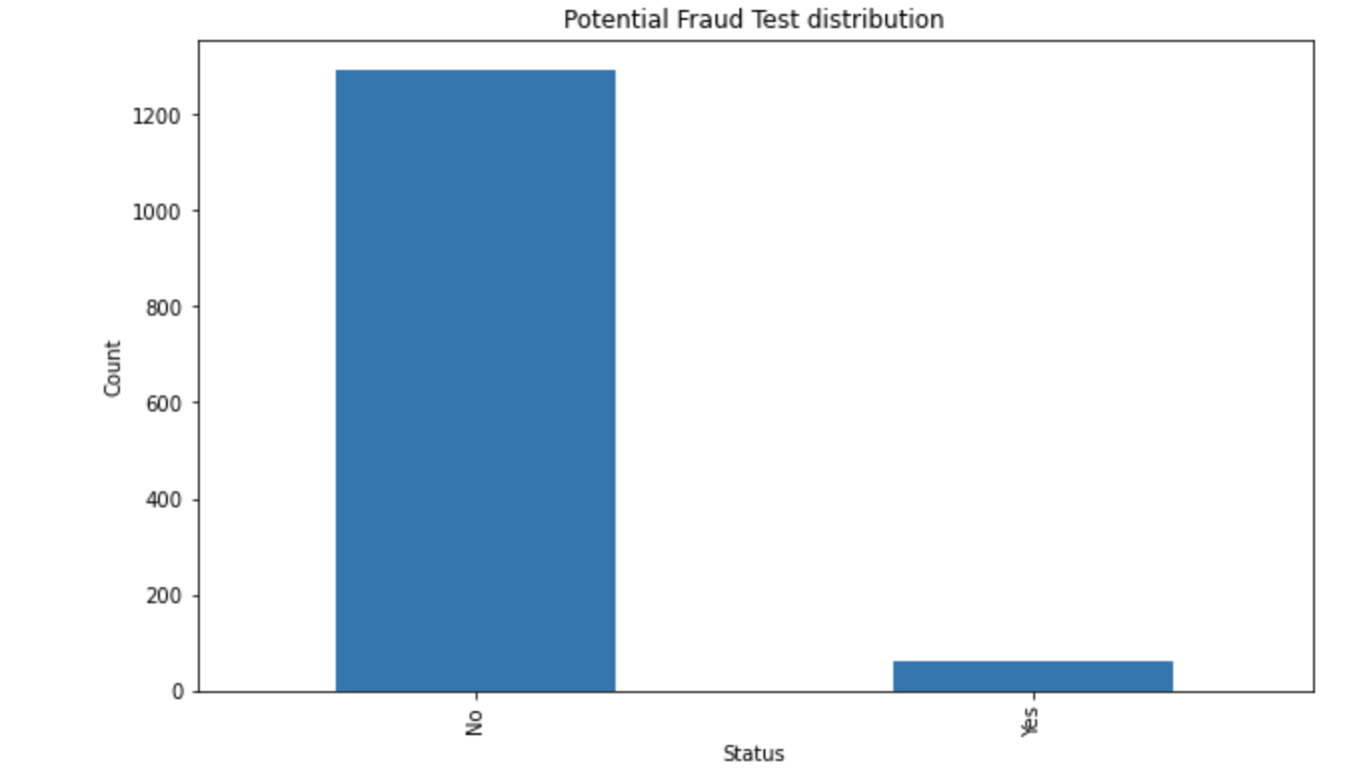
Logistic regression Vs Random Forest

Slide 16
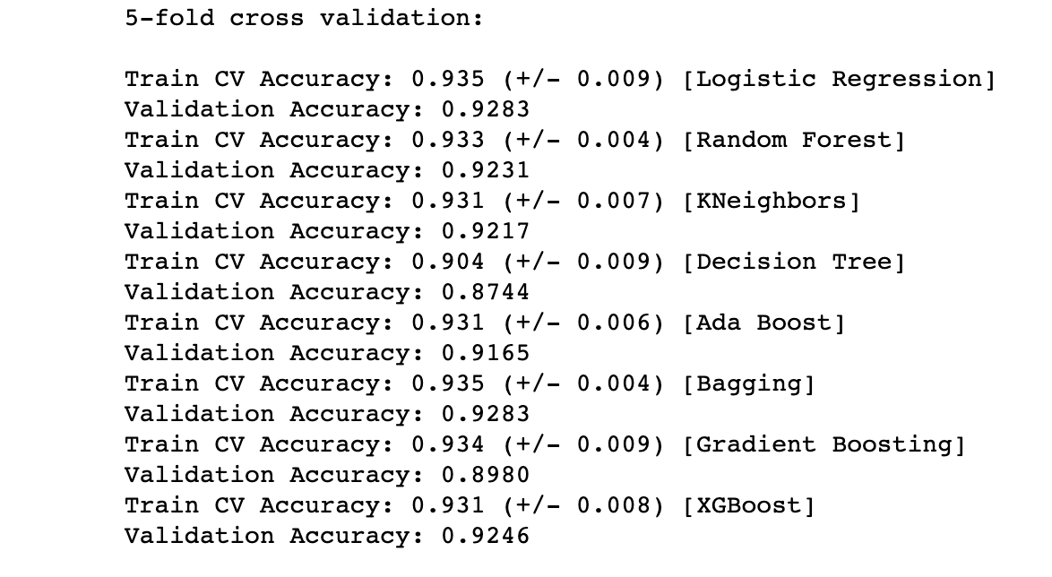
Other Models

Slide 17
Application
Health Insurance Organizations
Data Analytics Companies
US Healthcare Department

Slide 18
Conclusion
With this model, we predicted the potential fraud provider.
This project can be implemented on real world in healthcare insurance sector
Can also be used by data analytics organizations to find potential anomaly transactions or insurance claims
For further improvement, fraud claims can also be detected using this model with different dataset
Among all models, Logistic regression performance was best

Slide 19
Thank You!

